Slide 1
Resistors
Engr. Andrea alette r. morante

Slide 2
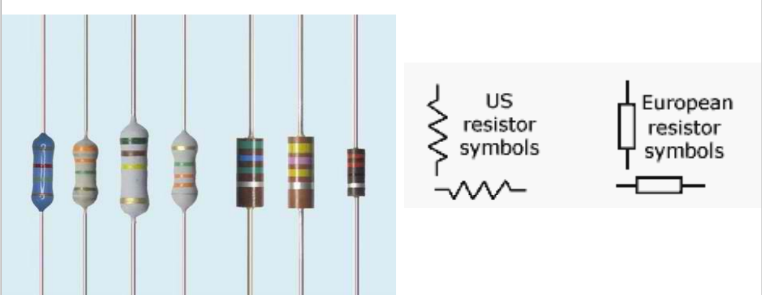
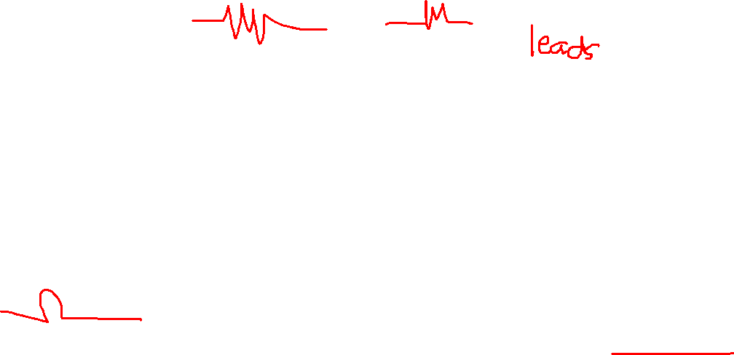
Resistor
A device that hinder the flow of current in the circuit.
The resistance, R, is the opposition to the flow of current. (Its unit is OHMS)

Slide 3
Three Factors to Consider in a Resistor
Type
Composition
Construction
Resistance Value
Wattage Rating

Slide 4
Types of Resistors According to Composition
Carbon Film
Carbon Composition
Metal Oxide Film
Precision Metal Film
Wire wound

Slide 5
Carbon Film
The most popular resistor type.
This resistor made by depositing a carbon film onto a small ceramic cylinder.
A small spiral groove cut into the film controls the amount of carbon between the leads, hence setting the resistance.
Such resistors show excellent reliability, excellent solderability, noise stability, moisture stability, and heat stability.
Typical power ratings range from 1/4 to 2 W. Resistances range from about 10 Ohm to 1 MOhm, with tolerances around 5 percent.

Slide 6
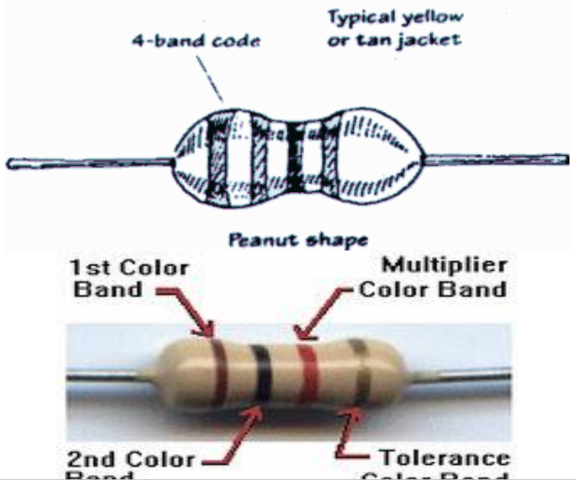
Carbon Film

Slide 7
Carbon Composition
This type is also popular. Its made from a mixture of carbon powder and glue like binder.
To increase the resistance, less carbon is added. These resistors show predictable performance, low inductance, and low capacitance.
Power ratings range from about 1/4 to 2 W. Resistances range from 1 Ohm to about 100 MOhm, with tolerances around +/- 5 percent.

Slide 8
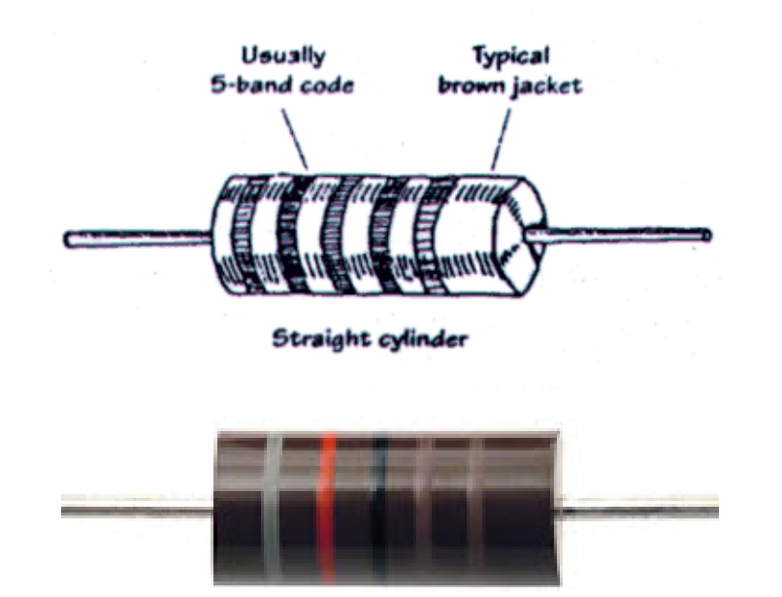
Carbon Composition

Slide 9
Metal Oxide Film
This type is general purpose resistor. It uses a ceramic core coated with a metal oxide film.
These resistors are mechanically and electrically stable and readable during high temperature operation.
They contain a special paint on their outer surfaces making them resistant to flames, solvents, heat, and humidity.
Typical resistances range from 1 Ohm to 200 kOhm, with typical tolerances of +/- 5 percent

Slide 10
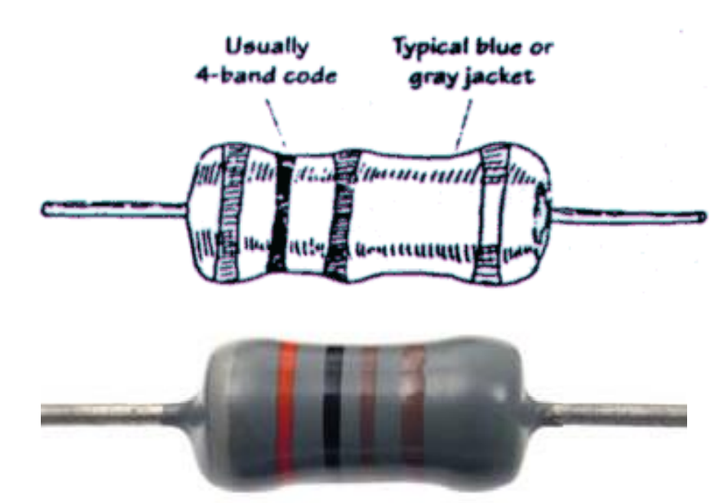
Metal Oxide Film

Slide 11
Precision Metal Film
This type is very accurate, ultra low noise resistor.
It uses a ceramic substrate coated with a metal film, all encased in an epoxy shell.
These resistors are used in precision devices, such as test instruments, digital and analog devices, and audio and video devices.
Resistances range from about 10 Ohm to 2 MOhm, with power rating from 1/4 to about 1/2 W, and tolerances of +/- 1 percent.

Slide 12
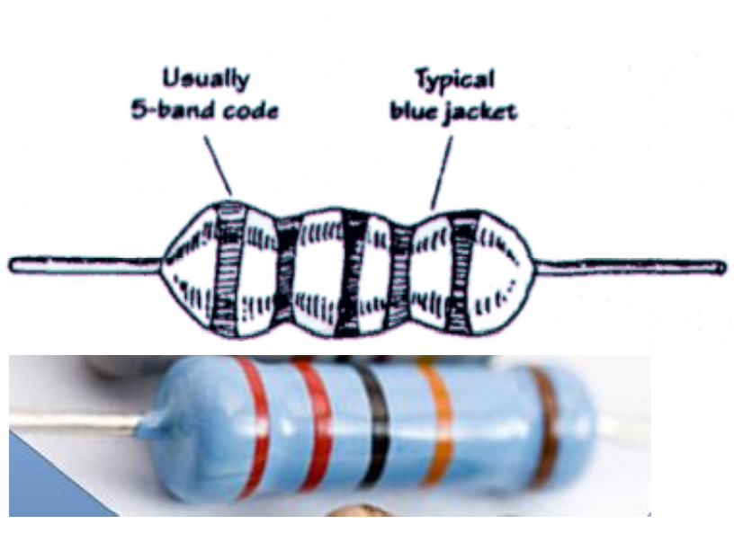
Precision Metal Film

Slide 13
Wire wound
Types include vitreous enamel coated, cement, and aluminum housed wire wound resistors.
Resistive elements are made from a resistive wire that is coiled around a ceramic cylinder.
These are the most durable of the resistors, with high heat dissipation and high temperature stability.
Resistances range from 0.1 Ohm to about 150 kOhm, with power ratings from around 2 W to as high as 500 W, or more.

Slide 14
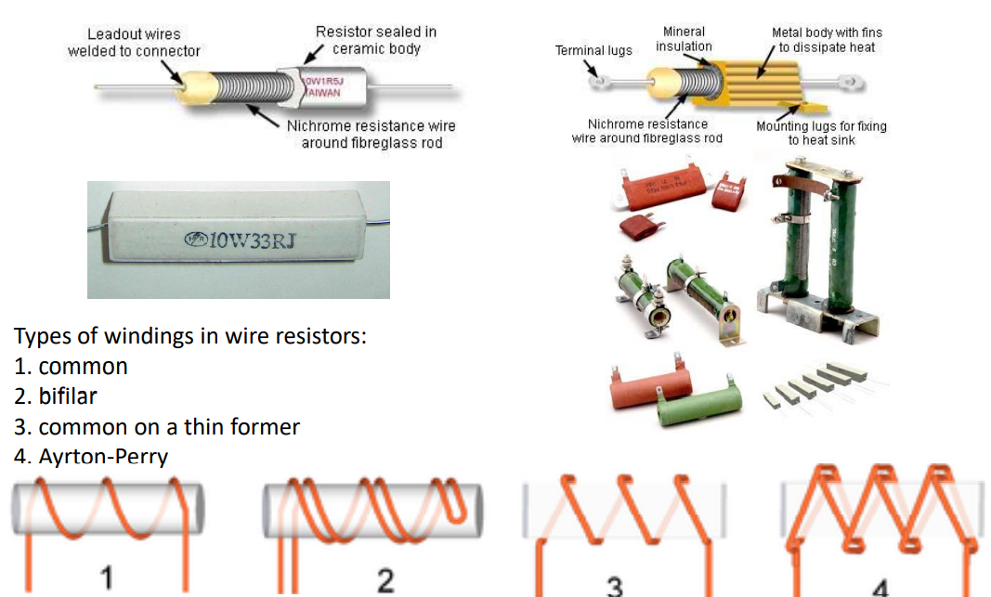
Wire wound

Slide 15
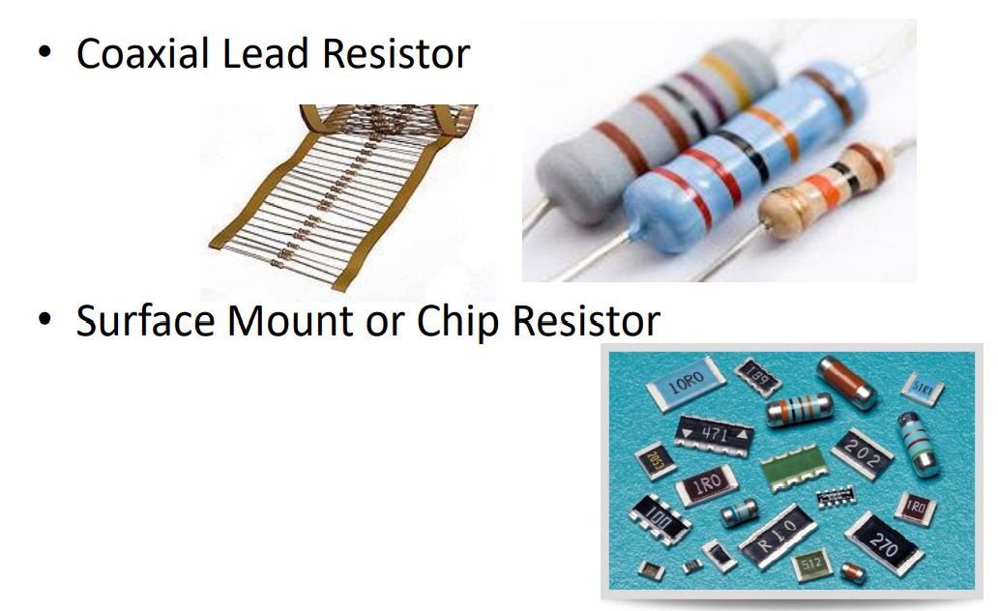

Types of Resistors According to Construction

Slide 16
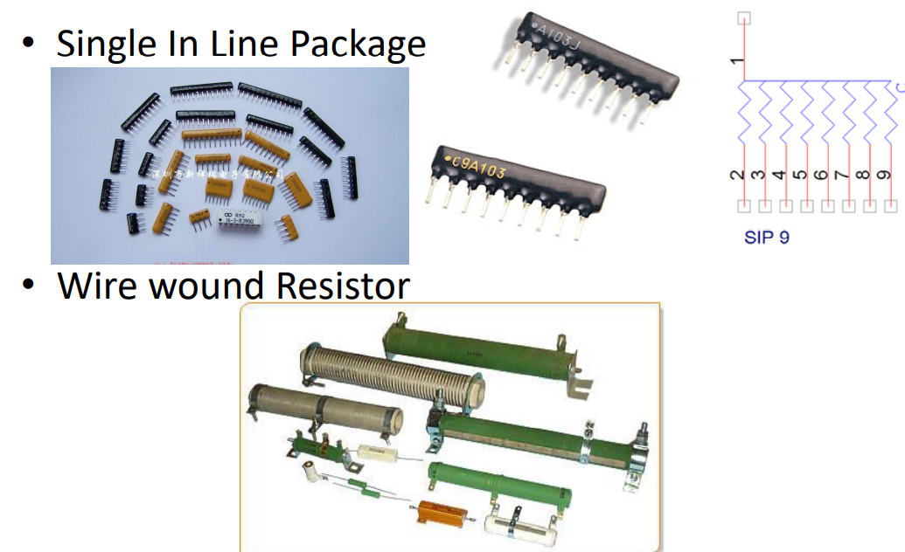
Types of Resistors According to Construction

Slide 17
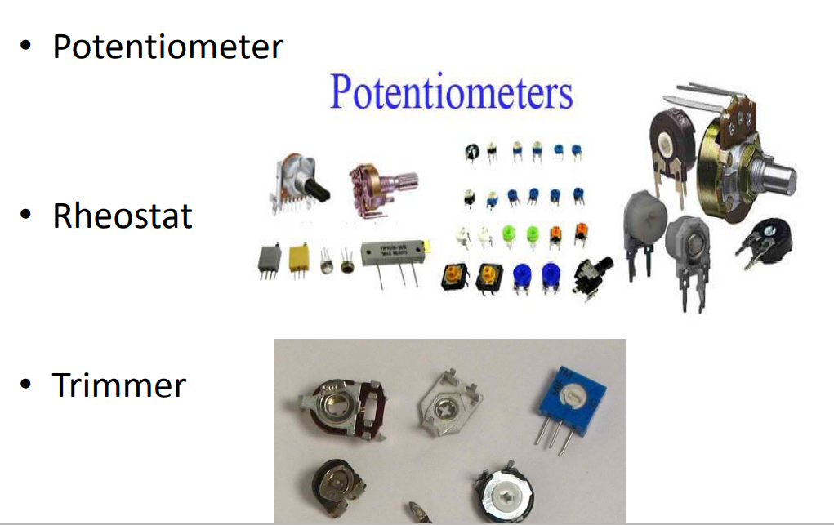
Types of Resistors According to Construction

Slide 18
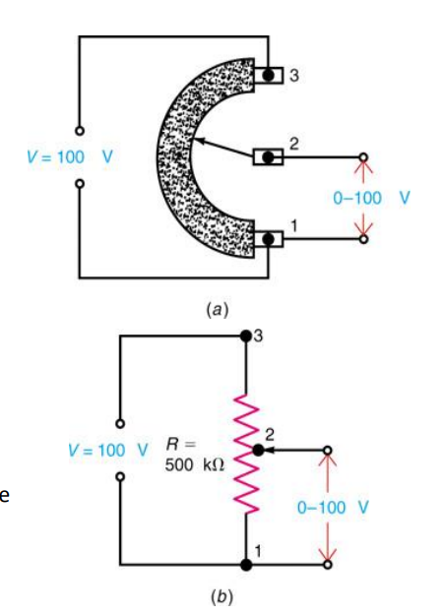
Rheostats and Potentiometers
Potentiometers
Potentiometers are three-terminal devices.
The applied V is input to the two end terminals of the potentiometer.
The variable V is output between the variable arm and an end terminal.

Slide 19
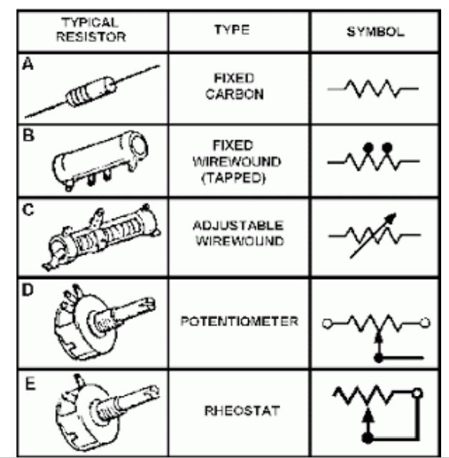
Types of Resistors According to Construction

Slide 20
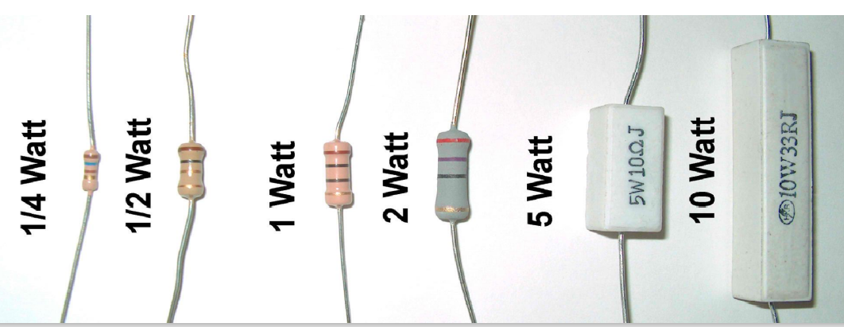
Types of Resistors According to Wattage
The wattage rating indicates the amount of power the resistor can safely dissipate as heat. The wattage rating is always more than the actual amount of power dissipated by the resistor, as a safety factor.

Slide 21
Power Rating of Resistors
In addition to having the required ohms value, a resistor should have a wattage rating high enough to dissipate the power produced by the current without becoming too hot.
Power rating depends on the resistor’s construction.
A larger physical size indicates a higher power rating.
Higher-wattage resistors can operate at higher temperatures.
Wire-wound resistors are physically larger and have higher power ratings than carbon resistors.

Slide 22
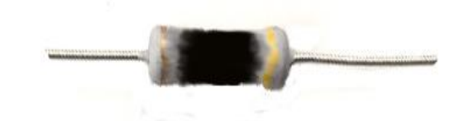
Power Rating of Resistors
When a resistor’s power rating is exceeded, it can burn open or drift way out of tolerance.
This is usually caused by a short somewhere else in the circuit which causes a high current to flow in the resistor.

Slide 23
Resistor Troubles
Resistors can become open or they can drift out of tolerance.
Some controls (especially volume and tone controls) may become noisy or scratchy-sounding, indicating a dirty or worn-out resistance element.
Due to the very nature of their construction, resistors can short out internally. They may, however, become short-circuited by another component in the circuit.

Slide 24
Resistor Color Coding
Carbon resistors are small, so their R value in ohms is marked using a color-coding system.
Colors represent numerical values.
Coding is standardized by the Electronic Industries Alliance (EIA).

Slide 25
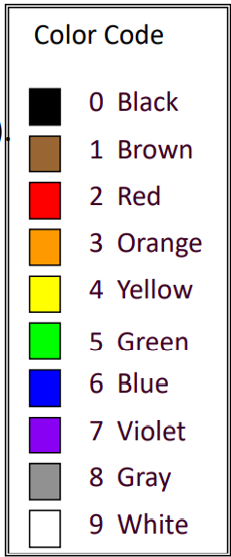
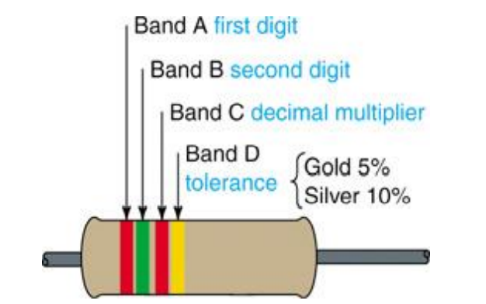
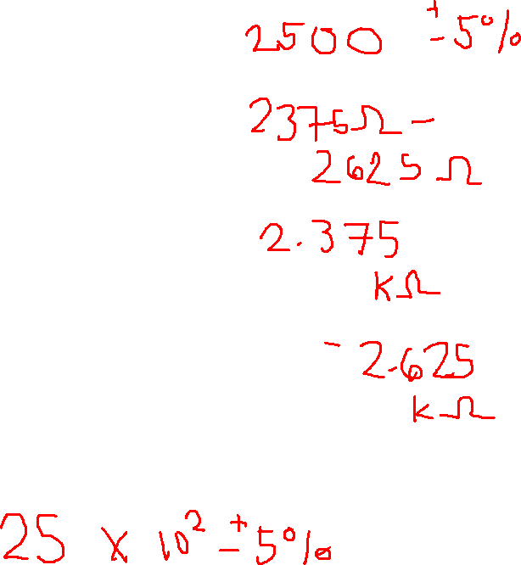
Resistor Color Coding

Slide 26
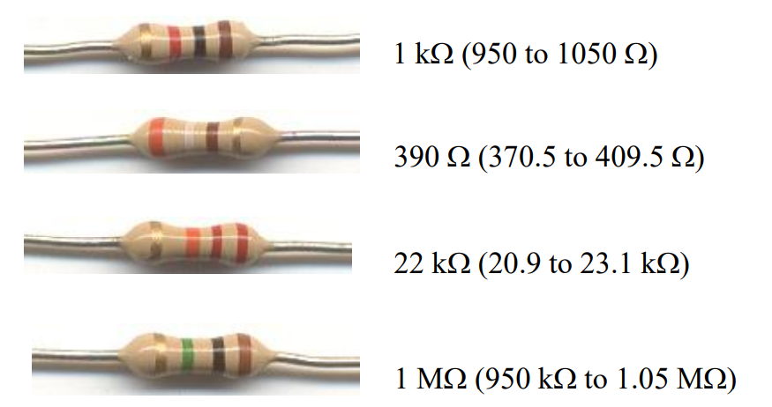

Resistor Color Coding
What is the nominal value and permissible ohmic range for each resistor shown?

Slide 27
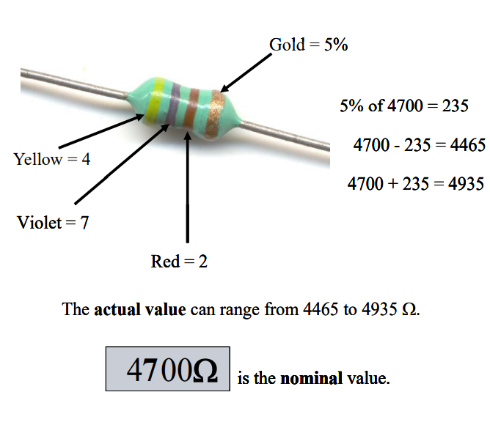

Resistor Color Coding
Applying the Color Code
The amount by which the actual R can differ from the color-coded value is its tolerance. Tolerance is usually stated in percentages.

Slide 28
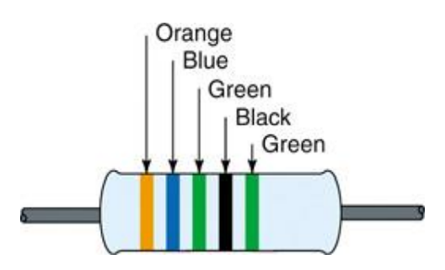
Resistor Color Coding
Five-Band Color Code
Precision resistors often use a five-band code to obtain more accurate R values.
The first three stripes indicate the first 3 digits in the R value.
The fourth stripe is the multiplier.
The tolerance is given by the fifth stripe.
Brown = 1%
Red = 2%
Green = 0.5%
Blue = 0.25%
Violet = 0.1%

Slide 29
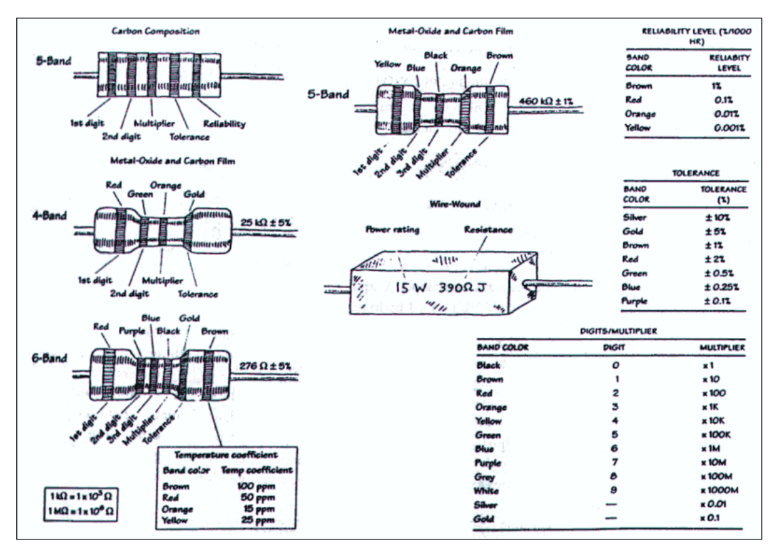

Slide 30
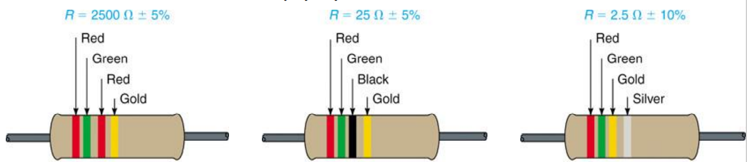
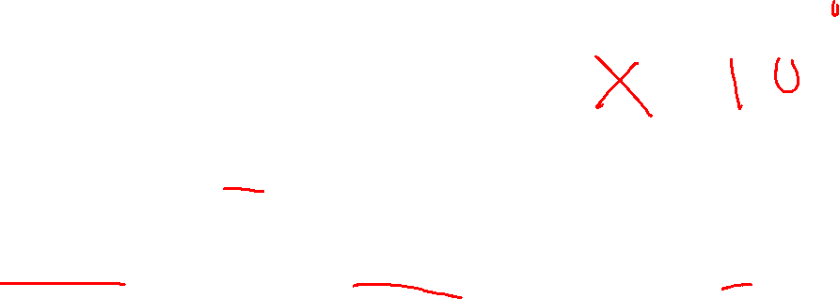
Resistor Color Coding
Resistors under 10 Ω:
The multiplier band is either gold or silver.
For gold, multiply by 0.1.
For silver, multiply by 0.01.

Slide 31
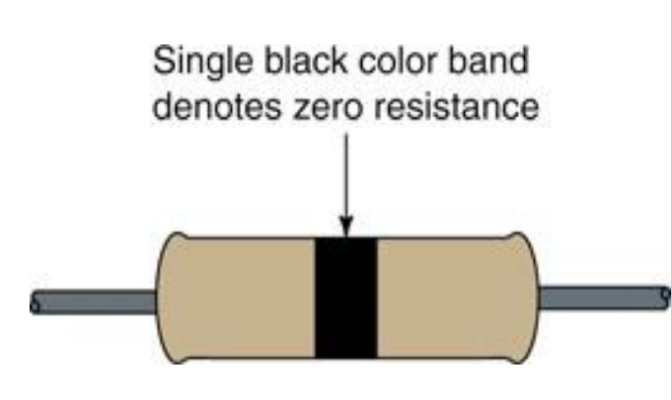
Resistor Color Coding
Zero-Ohm Resistor
Has zero ohms of resistance.
Used for connecting two points on a printed-circuit board.
Body has a single black band around it.
Wattage ratings are typically 1/8- or 1/4-watt.

Slide 32
COMBINING RESISTANCE
We can connect different resistor to get different value of resistance.
The value of the new resistance is depending on their connection
Connection can be:
Series
Parallel

Slide 33
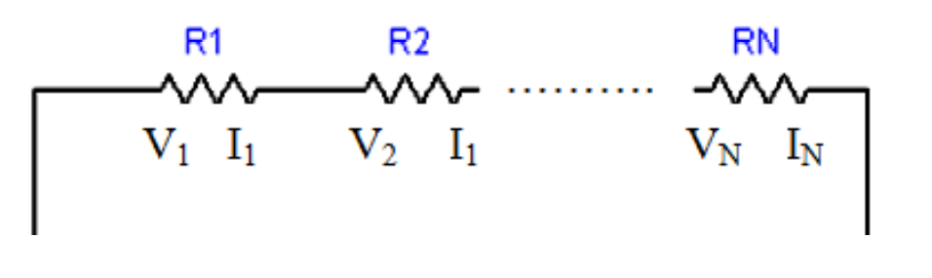
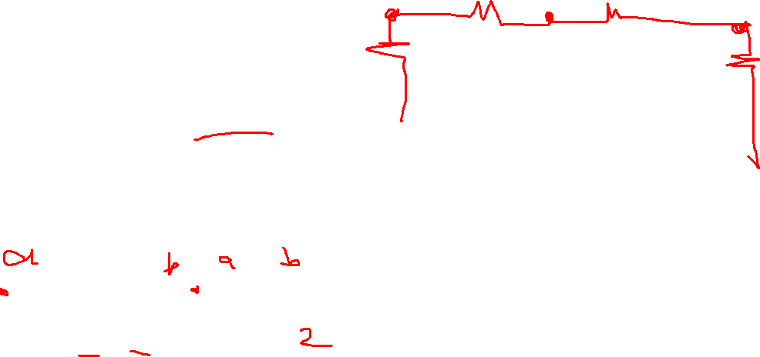
Circuit Connection
Series - Two or more branches are cascaded or one end of the branch is connected to another end of another branch sharing a single node.

Slide 34
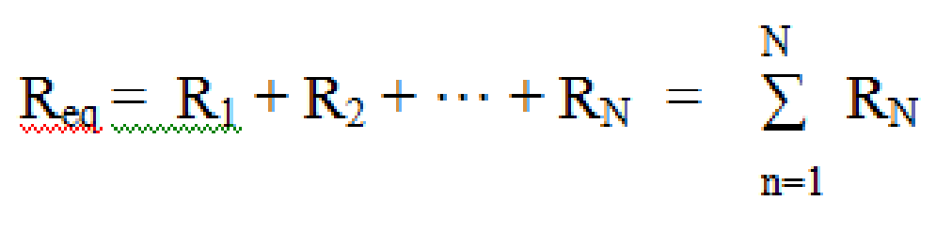
Total Resistance in Series Connection
The equivalent resistance of any number of resistors connected in series is the sum of the individual resistances.

Slide 35
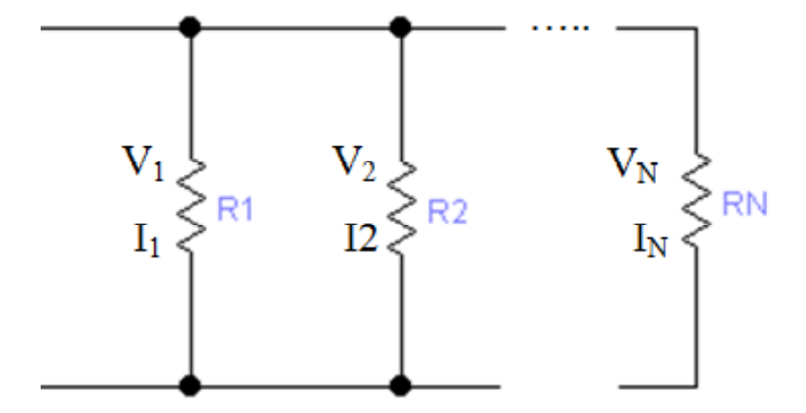
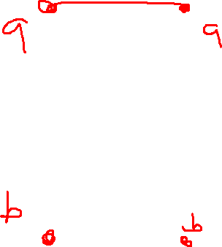
Circuit Connection
Parallel - Two or more branches are connected to the same two nodes.

Slide 36
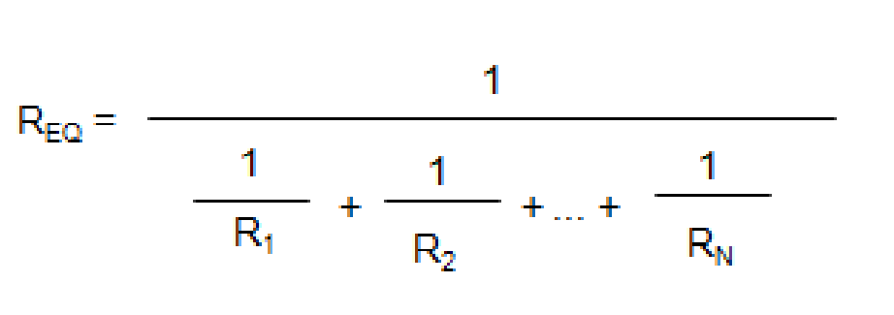

Total Resistance in Parallel Connection
The equivalent resistance of a parallel circuit equals the reciprocal of the sum of the reciprocals.

Slide 37
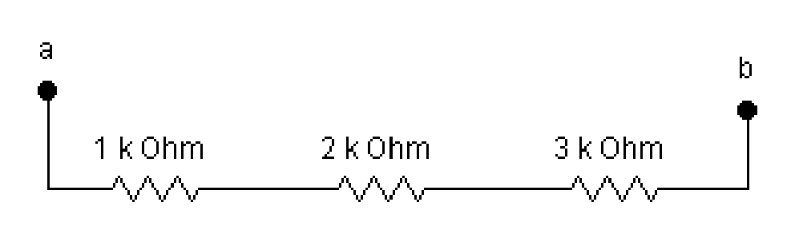

Example
Find the total resistance of the circuit.

Slide 38
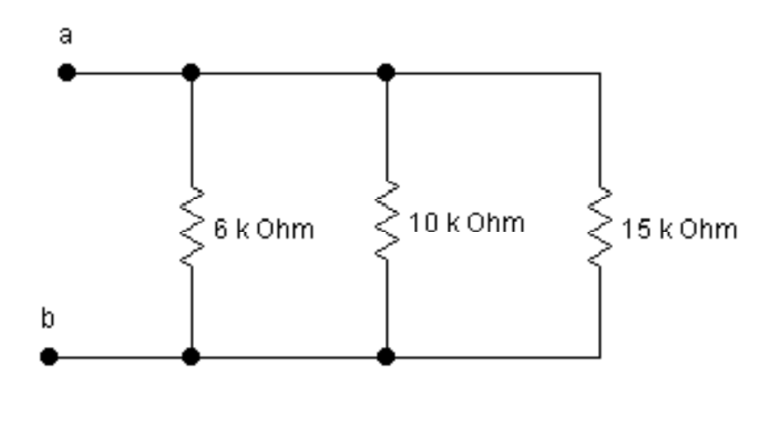
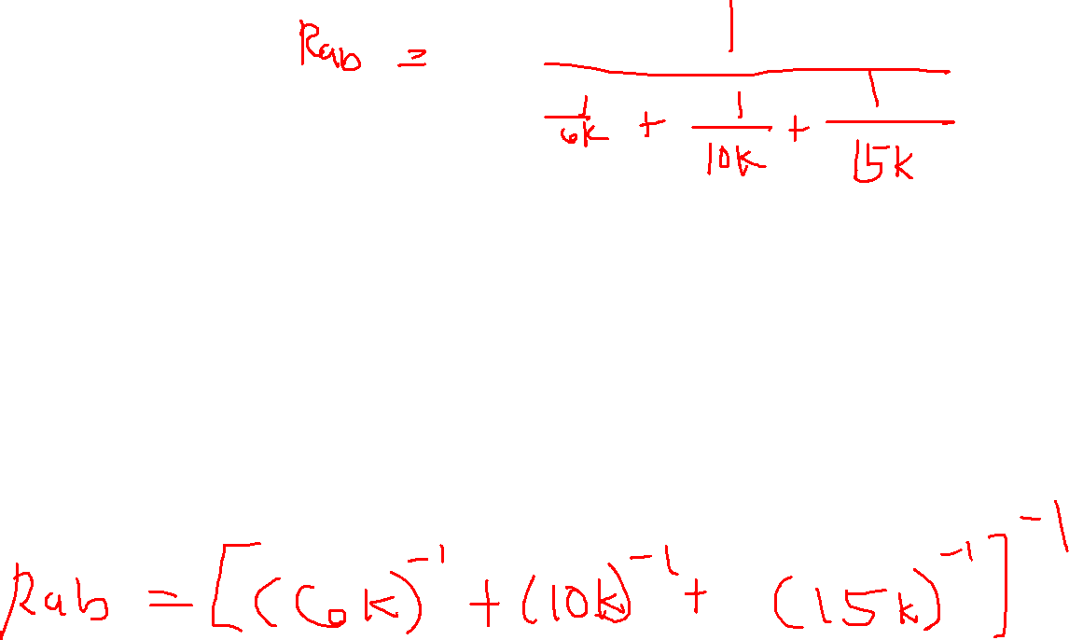
Example
Find the total resistance of the circuit.

Slide 39
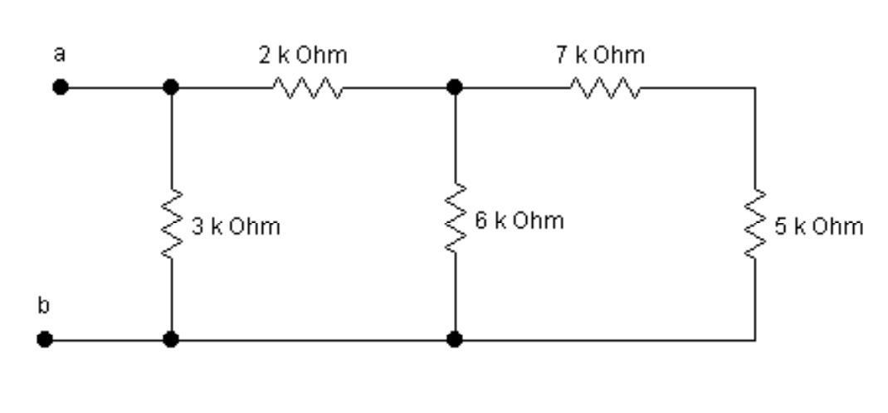
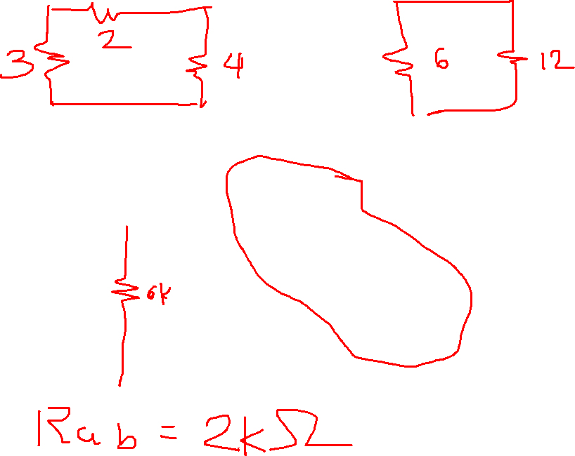
Example
Find the total resistance of the circuit.

Slide 40
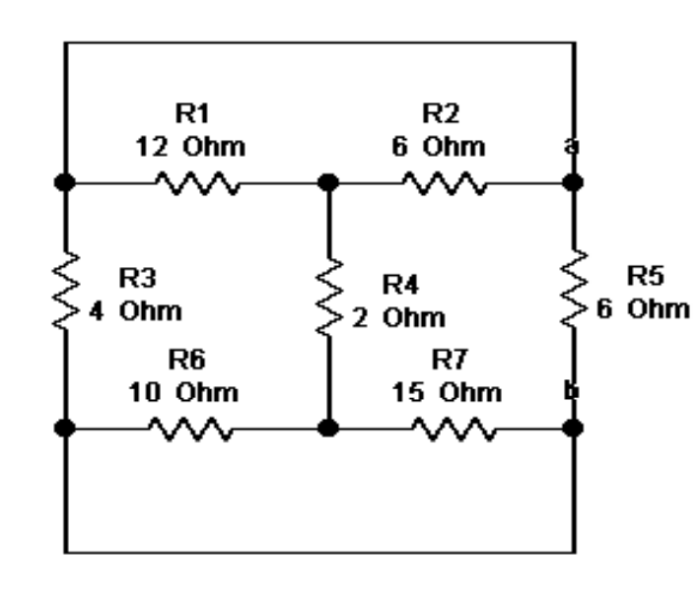
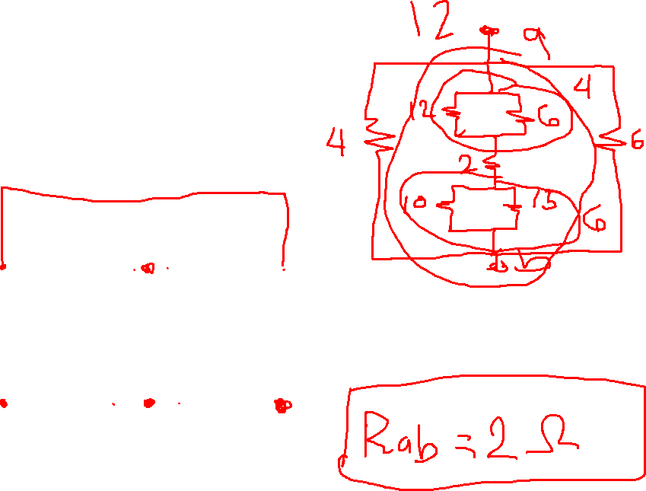
Example
Find the total resistance of the circuit.

Slide 41
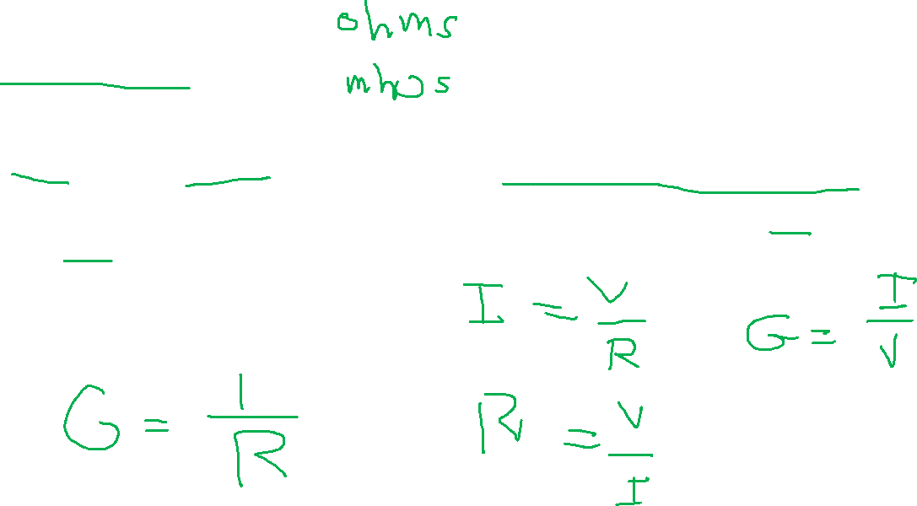
Conductance
the degree to which an object conducts electricity, calculated as the ratio of the current that flows to the potential difference present.
This is the reciprocal of the resistance and is measured in siemens or mhos.
Symbol: G.

Slide 42
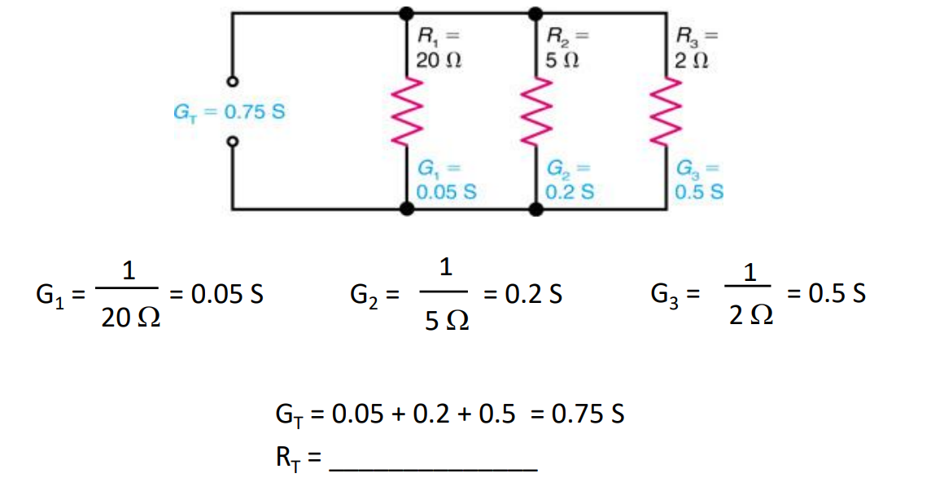
Example
Find the total conductance and resistance of the circuit.

